Slide 1

EM Simplification Recommendations
October 3, 2016

Slide 2
What can you simplify?
Business Process Simplification
Have a local business lead driving the review and requirements instead of a middle layer
Are there processes that could be streamlined if there were compliance and/or SOP updates?
Review pain points of handoffs between meeting execution team members
Technical System Simplification
Getting back to ‘core’ vs. custom wherever possible
Flexibility to support legal/regulatory needs of individual markets while adhering to global core standard
Can we improve the method of Requirements gathering to make market rollouts more efficient?
Understand the legal/compliance requirements before going in to ensure Global and Local Business process are aligned, thus minimizing new requirements
Market completion of a ‘configuration checklist’ ahead of time

Slide 3
System Simplification Specifics

Slide 4
Need
Systematically, the Need is low-maintenance – built off an existing Veeva OOTB object (Budget) – Recommend to leave
Customization in this area relates to need inheritance
Training/Alpha/UFT experience: It has proven to be a smooth transition and understanding.
Recommended enhancements:
Reduce Need to 1 record type to eliminate confusion and simplify (currently 3)
Remove the inheritance piece or ONLY have the inheritance piece
Remove the approval process if it’s already approved in RPM.
Automatically Share- Business would have to define Sharing Rules.
Benefit of the “Need”: leverages the Veeva OOTB Budget object where the Rollups are calculated by Product.

Slide 5
Activity
Activity Simplifications
Potential for activity flows to be modeled on team member hand-offs – UFT feedback indicated current flow is confusing.
Have users specifically click a button to get the Activity into “In SC Review” – one of the feedback during UFT from the field was that just adding an SC moves the activity to In SC Review and they may not have meant to hand off to SC yet
Decrease Status Transitions (3-4 statuses only)
In Draft – PO does whatever they need to do before involving a SC
In SC Review – SC does whatever they need to do including communicating back and forth with SC
Pending Approval – SC or PO submits for Approval
Approved/In Planning –
Post approval activities can be performed by SC and/or PO
Attaches the materials that are required prior to Closeout
Can have an additional field to indicate the Stage instead of full Status transitions if required
In Closeout
Archived
Do we really need In Execution, In Post Execution?
Not only does a reduction in statuses reduce confusion/complexity, but also reduces the number of global page layouts. This would simplify future rollouts and application maintenance.

Slide 6
Activity Con’t
Leverage V27 Approval updates. Specific examples:
Criteria-based entry to Approval Workflows (e.g. if estimated costs exceed $2,000, approval from finance is required. Otherwise, the event can be auto-approved.)
Automated routing to a particular user for approval
Automated routing to a particular group for approval
Automated field updates, task creation, email alerts, and outbound messages to other systems as approval steps are entered or completed
In Service Coordinator Review:
Is it simply a review? Are they ever actually updating the record? If not, let it be part of the approval process.
To get the Activity into Review/Approval, the only function the PO can’t do on the iPad is Setup Contracts and ICF (*Participants note on next slide). How can we eliminate this step to make full use of the user-friendly iPad UI?
Notes:
- Speaker Pool/Bureau

Slide 7
Activity Con’t
Strive to have Global Page layouts (which is the case now) –
Market-specific layouts are do-able if required
Reduce to Activity types to Services, Sponsorship/Preceptorship & EBD.
This would reduce the associated number of page layouts from ~90 to ~30.
*Remove the use of Participants object especially from the Activity – exists at the Need
Custom object that does not sit well with iRep model
Move this to a flat structure or just refer to the Need to look at what kind of Participants are supposed to invited/added to the Activity
Remember that Product supports market-specific Activity flows

Slide 8
ICF/Contracting
In general, the most customized
Recommend HCP Contracting, ICF, and Vendor Setup (VMF,VMT) occur external to Veeva EM (Ariba)
Brings product closer to OOTB
Simpler market implementations for EM – no contract template setups by market, translations, simpler training
Contract templates, translations time consuming
Turn off dependence on Conga – elimination of Conga licensing
Less testing required; no legal input on templates required
Reduces PII exposure; eliminates PII encryption and encryption license costs
Process Contract Party is confusing to users
Can simply manually upload & activate signed contract
No contract specialist knowledge required

Slide 9
Invoicing/Payments
Remove/turn-off dependence on Conga for Invoices
Pass on an Invoice template as a Material that users can use to do their invoicing paper based and then attach it back into the system
Users can create PO or Check request – system can be configured for users to choose one or the other or a combination of the two
This just means configuration of a new Expense Header recordtype and/or reusing existing model for Check request with Check request fields

Slide 10
Recommendation

Slide 11
IT Recommendation – Hybrid Approach
Take the Germany/Brazil Framework and simplify certain areas
Ex: contracting – but has dependence on HCP contracts being available in Ariba, reduction in number of need types, etc.
Pros
Reduces system complexity, training and legal involvement
Implementation time by market is dramatically reduced
Cons
Manual ICF & Contracting – how do they do it today?
Some up-front work required, but should be offset by reduced implementation times within markets

Slide 12
Backup Slides

Slide 13
Option A – Current EM Solution
Continue rolling out with what Germany & Brazil have
Pros
End to End Event Management solution in one system
Process definition, deployment strategy, change management and communication have been defined & implemented. We know what to expect.
Ability to gain live end-user feedback for future enhancements
Quicker rollouts now that the Core build is in LatAm and EU Orgs
Cons
Complexity due to Contracts, Echosign and other market-specific templates has proven timely.

Slide 14
Option B – Complete Simplification
Simplify the system & process
Ie, Completely take out contracting, ICF; removing approvals where possible, reduce statuses, leveraging speaker bureau & qualifications…
Pros
Reduces system complexity & maintenance
Once system & process are re-defined, rollouts should be very quick
Cons
Will this require process re-engineering?
Some system re-design will be required along with another big deployment
Will you build out Ariba for ICF & Contracting?
How to handle Germany & Brazil?
*Note the system supports parallel solutions

Slide 15
Note on Speaker Bureau Simplification
Speakers will be vetted and contracted to be made Eligible for addition to Activities prior to or separate from creating an activity
Although Contracting will be external to Veeva, Contract information can be stored in the Out of the box Veeva Contract objects (that we leverage today)
This can be leveraged in an Product supported manner where the transition occurs from Contracted services to Speaker Qualification records on Contract activation completely out of the box
May require moving away from a strictly Event originated Contracting to Contracting process linked directly to the Speaker/Service Provider
This could mean we simply move what we built now to be used direclty to the Speaker/Service Provider which will need somewhat of a process and system redesign

Slide 16
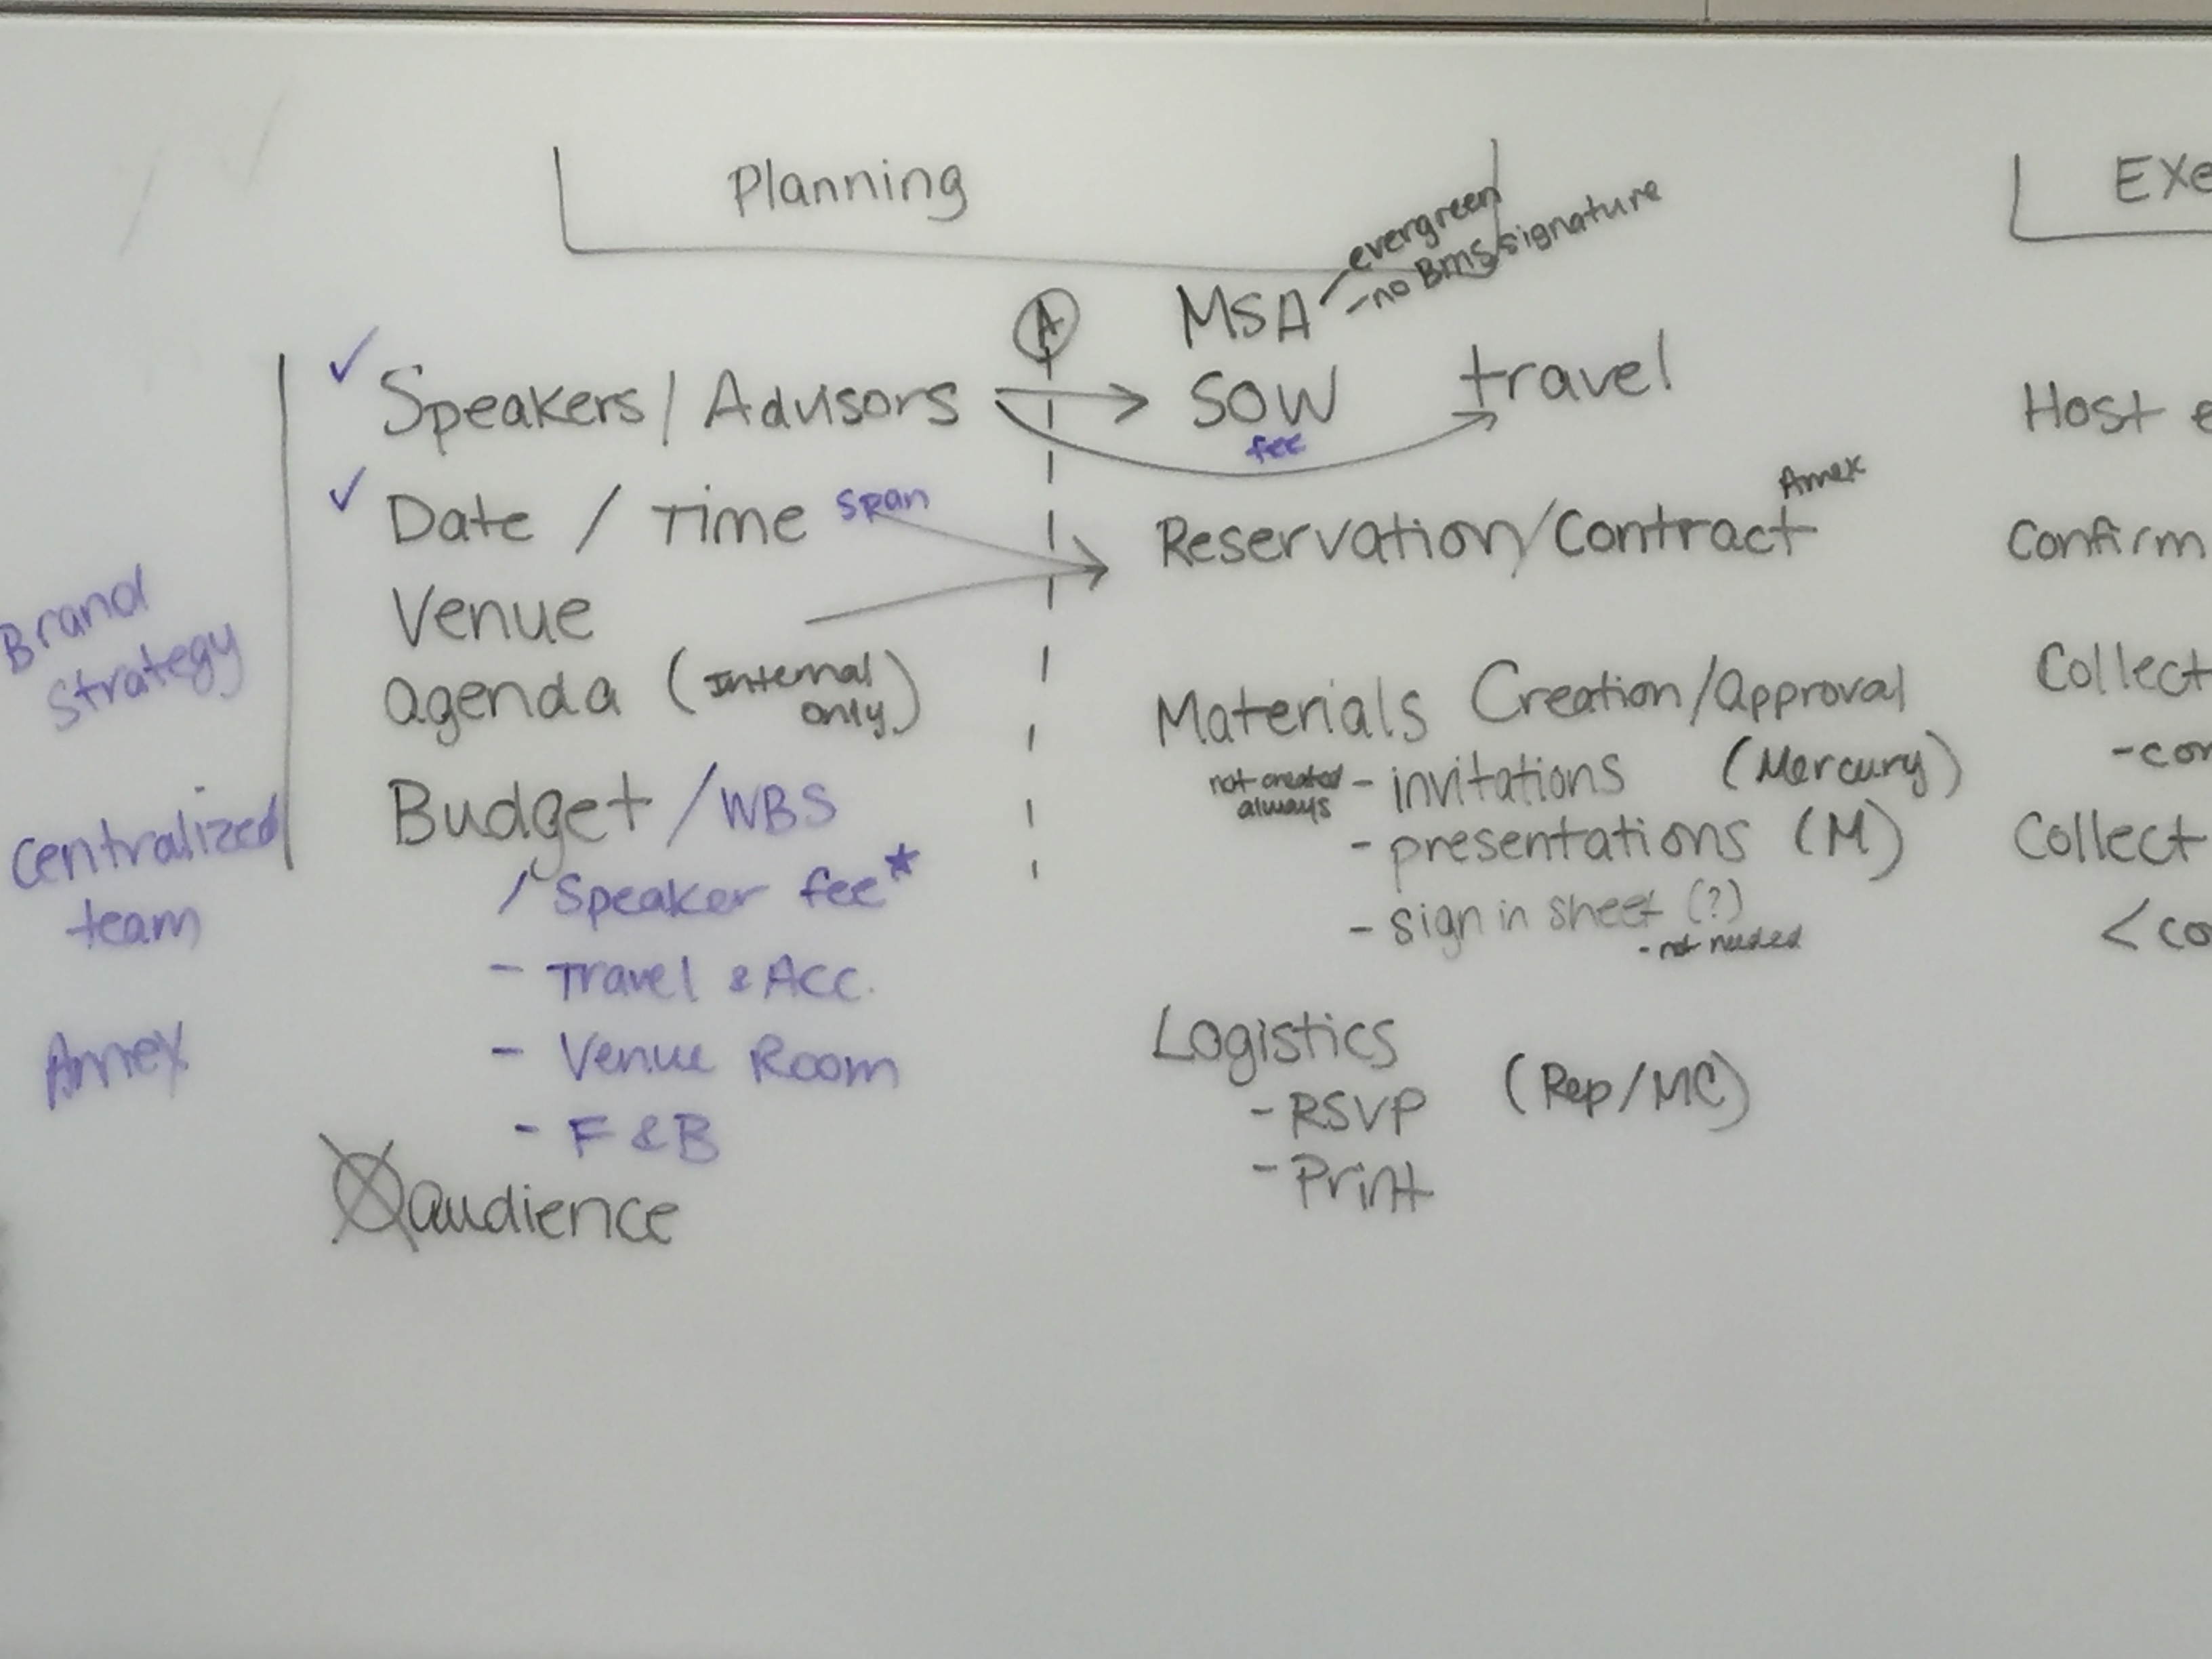
Planning phase

Slide 17
Planning phase – Stand alone
Activity | Responsible Team/Owner | Sequence
Budget Funding – WBS/CC | Approved outside Veeva | 1
WBS/CC gets used at an Activity | Project owner
 |  | 1
Speaker Pool creation – Speakers, Contracting, Make ready for use at an Activity. This could be by FY/CY, Specifically by large Congresses, Ad-hoc additions to Speaker Pool | Who does this?? Service Coordinators in coordination with Project Owners based on available Budgets/Guidance from Central Leadership? | 2
Meeting Logistics Planning/Venue/Agenda/Materials | Project Owner? | 3 (2?)
Meeting Speaker/Advisor Nominations | Project Owner? | 3
Meeting Expense Estimate Planning/Confirmations | Project Owner? | 3/4
Meeting Speaker Confirmations | Project Owner/Amex/Starcite? | 5
Meeting Approvals? | Approver | 4? 6?
Confirm Services with Confirmed Speakers/Advisors? | ? | ?

Slide 18
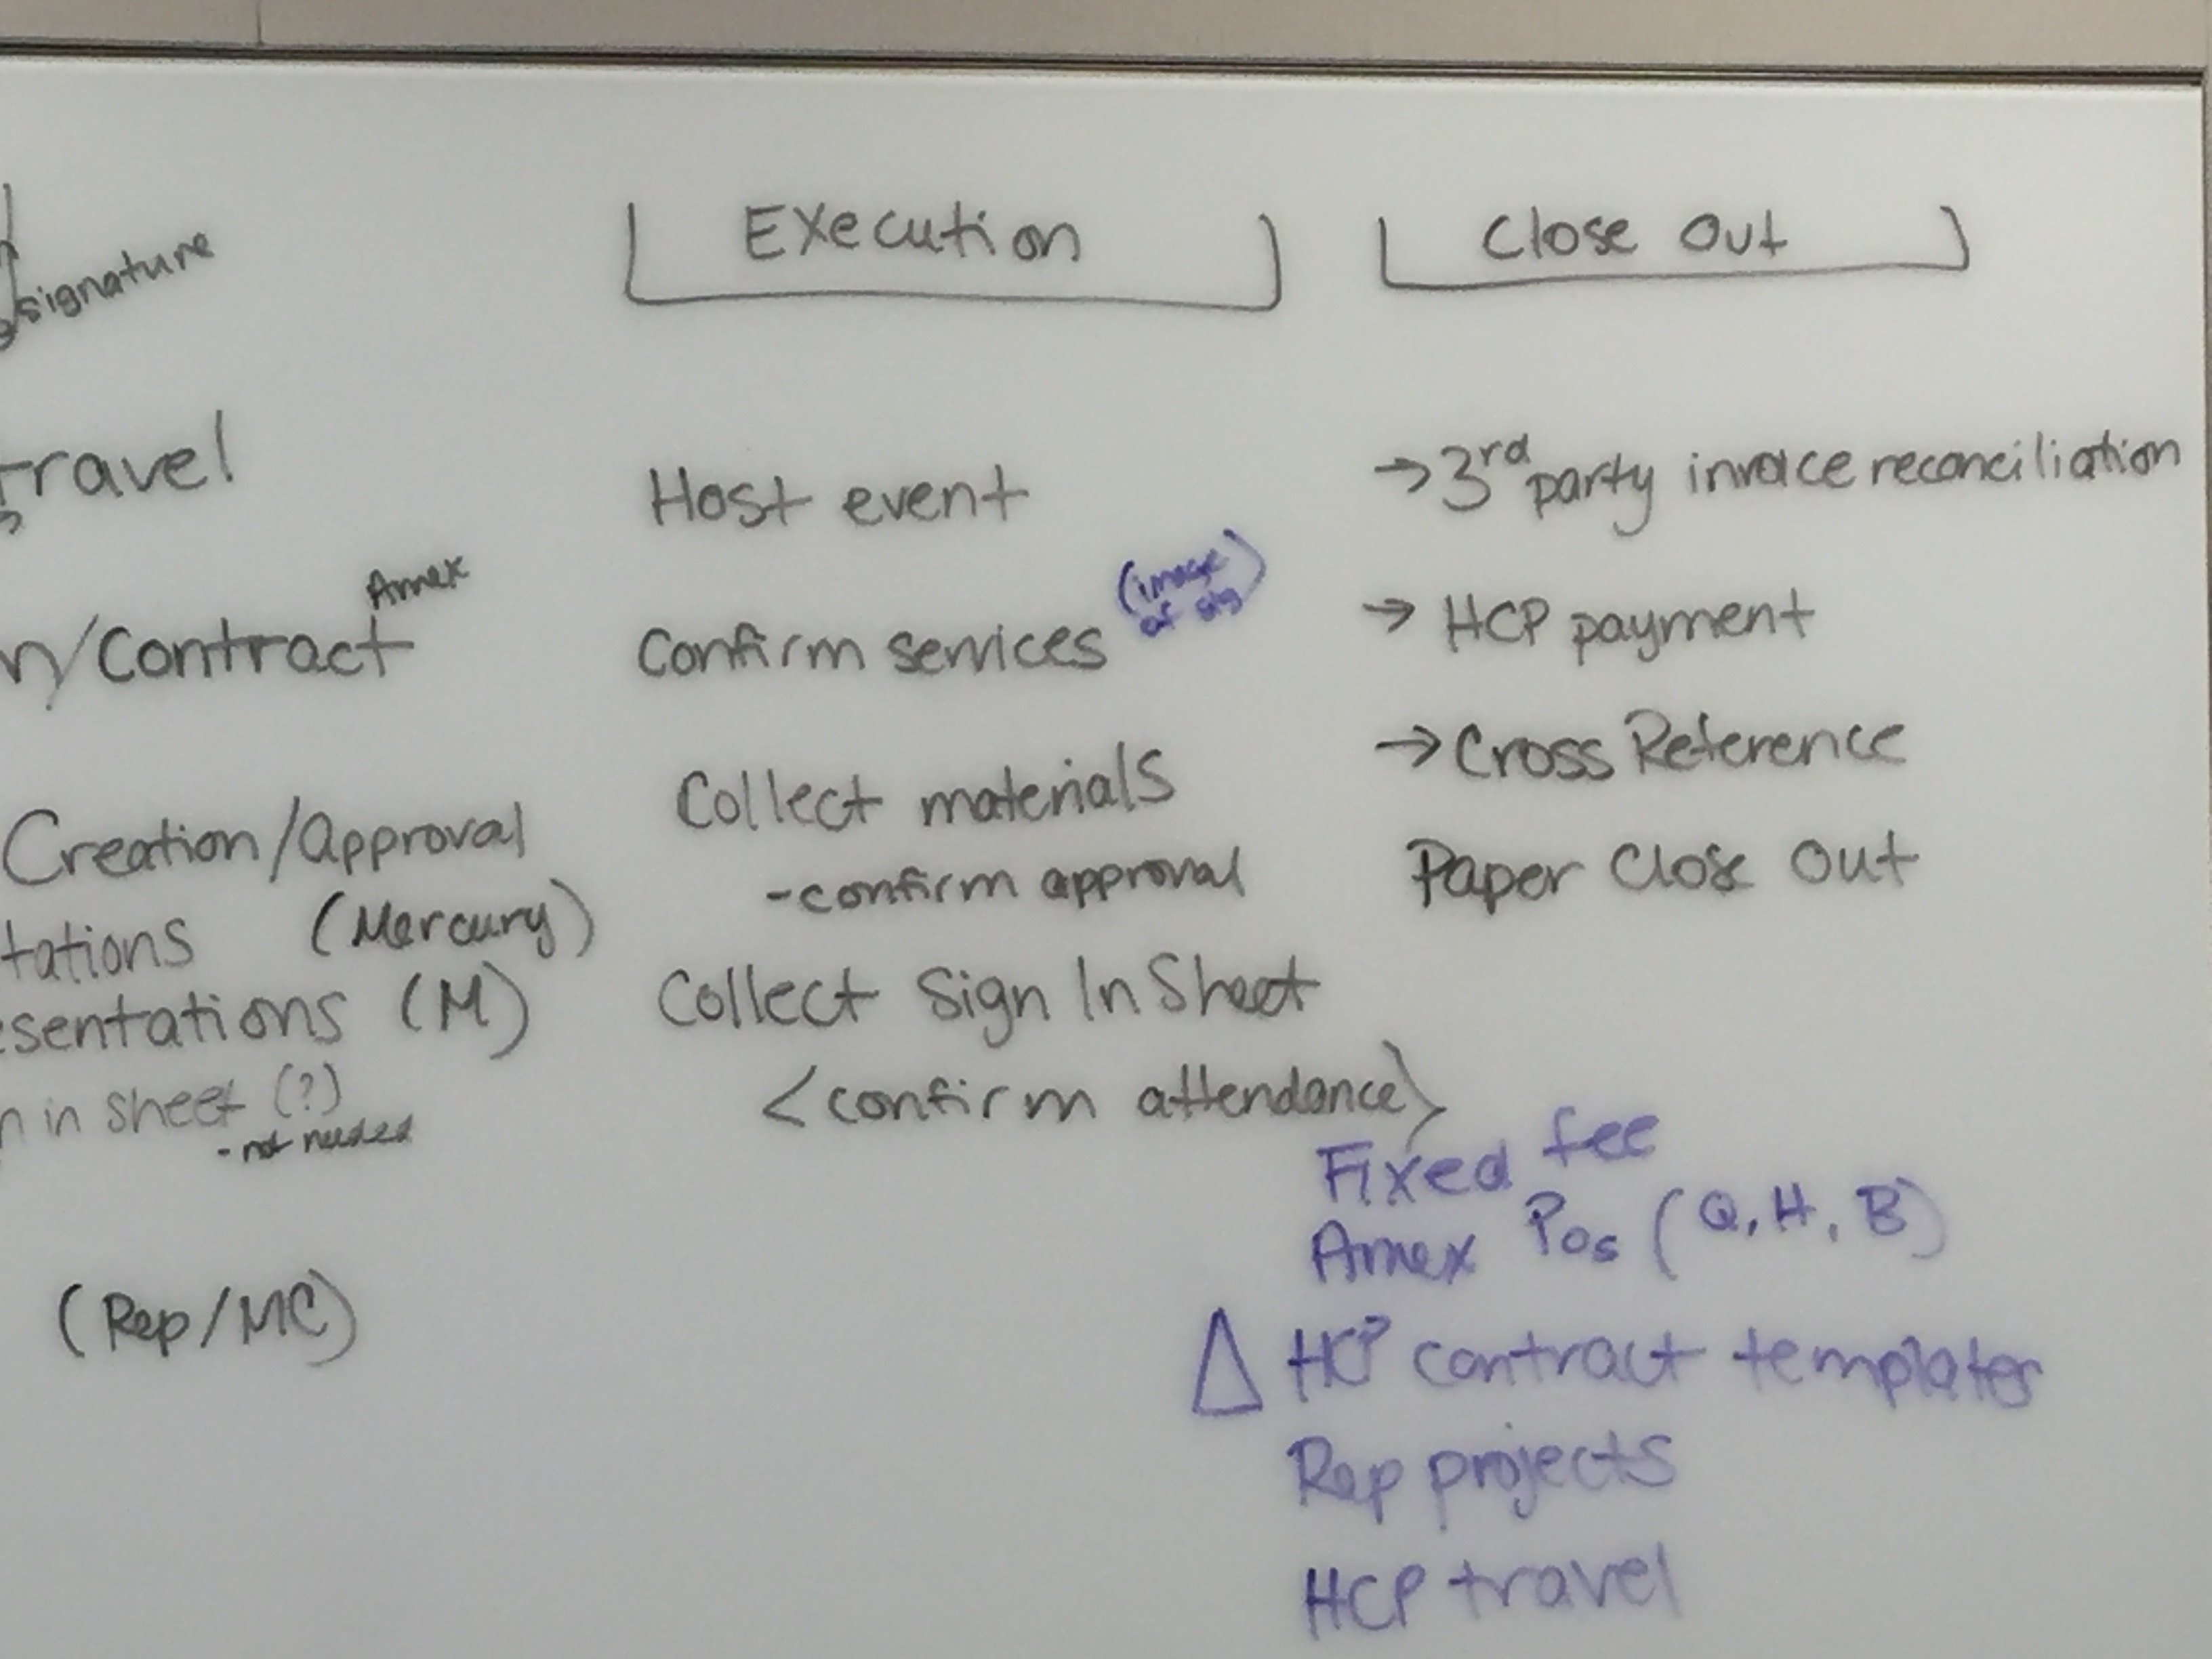
Event Execution

Slide 19
Event Execution
Activity | Responsible Team/Owner | Sequence
Add Team members | Project Owner | -
Add Audience members/Reconcile Walk-ins | Project Owner/Team Members | -
Collect Digital Signatures on IRep | Project Owner/Team Members | -
Collect Paper Signatures/Sign-in sheet | Project Owner/Team Members | -
Collect Materials/Slide-decks | Project Owner/Team Members | -
Enter/capture spend | Project Owner/Team Members | -
Ready for Closeout | Project Owner/Amex/Starcite? | -

Slide 20
Event Closeout
Activity | Responsible Team/Owner | Sequence
Enter Expense reports in Concur | Project Owner/Team Members | -
Enter Invoices in Veeva ➔ Ariba | Project Owner/Team Members | -
Wait for Expenses and Invoices to flow back into Veeva | Project Owner/Team Members | -
Close the Event | PO/Service Coordinator? | -
 |  | -
 |  | -

